Slide 1

Software Design and architecture (SE322) gg
Week 14
Said Nabi
said.nabi@giki.edu.pk
Faculty of Computer Science and engineering
Gik Institute Topi, Swabi

Slide 2
List of Topics
Microservices Based Architecture and pipe and Filter Architecture pattern

Slide 3
Microservices Based Architecture
A Microservice is an architectural style that structures an application as a collection of loosely coupled, independently deployable services.
Each service is organized around a specific business capability and can be developed, deployed, and scaled independently.
Monolithic applications suffer from slow development cycles, inefficient scaling, rigid technology lock-in, and overall fragility.
A small bug can impact the entire system, and microservices were created specifically to solve these issues.
Microservices aren’t just small services—they rely on clear principles like single responsibility, independence, strong APIs, separate data, and built-in resilience, supported by tools for routing, discovery, communication, monitoring, and container management.
Adopting microservices is a slow, step-by-step process, often using the Strangler Fig Pattern, and they should be avoided for simple apps, inexperienced teams, or unclear domains.

Slide 4
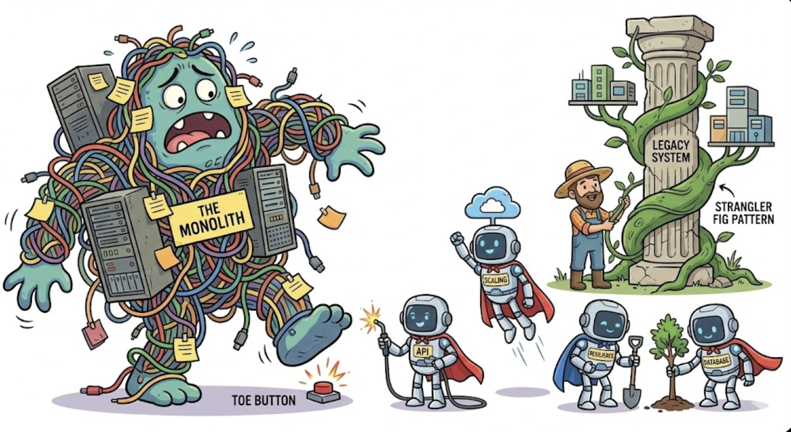

Slide 5
SOA Software Architecture
Like microservices, SOA is about building applications from a collection of services. The core idea is the same.
But instead of letting services talk directly to each other, SOA often used a central traffic controller called an Enterprise Service Bus (ESB).
ESB is a central hub that handles communication, routing, and rules.
SOA was designed for a different world—a world of on-premise servers and integrating massive, stable enterprise systems.
It was less about speed and more about standardization and reuse across a large organization
So, when the cloud and DevOps came along, we needed a more agile, independent, and faster way to build services.
This led to the birth of microservices, taking the core idea of SOA and adapting it for the modern era.

Slide 6
SOA Software Architecture cont..
SOA wasn't just about breaking down applications. It was driven by two primary business goals at an enterprise scale:
Reusability: Build a business capability once (e.g., "Get Customer Credit Score") and reuse it across many different applications (web portal, mobile app, internal CRM). This saves time and ensures consistency.
Interoperability: Make different, often old and incompatible, systems work together seamlessly. SOA was the original "API-fication" of the enterprise.
Key Mindset Shift from Monolith:
From: Let's build one giant application.
To: Let's expose our core business functions as reusable services.
The most critical component in a traditional SOA is the Enterprise Service Bus (ESB). It routes messages, transforms formats, enriches data, and manages multi-step business processes.

Slide 7
SOA vs Microservices
SOA Problem | Microservice Solution
Central, Heavy ESB | Services are intelligent and handle logic themselves. Communication is lightweight (e.g., REST APIs). An API Gateway is used only for simple routing, not complex orchestration.
Centralized Governance | Decentralized Governance: Each team owns its service and is responsible for its own standards, technology, and deployment.
Shared Database | Database per Service: Each service owns its own data, ensuring true independence and preventing tight coupling.
Large, Coordinated Deployments | Independent Deployment: Each service can be built, tested, and deployed completely on its own, without affecting any other service.
Single Technology Stack | Polyglot Architecture: Teams can choose the best programming languages

Slide 8
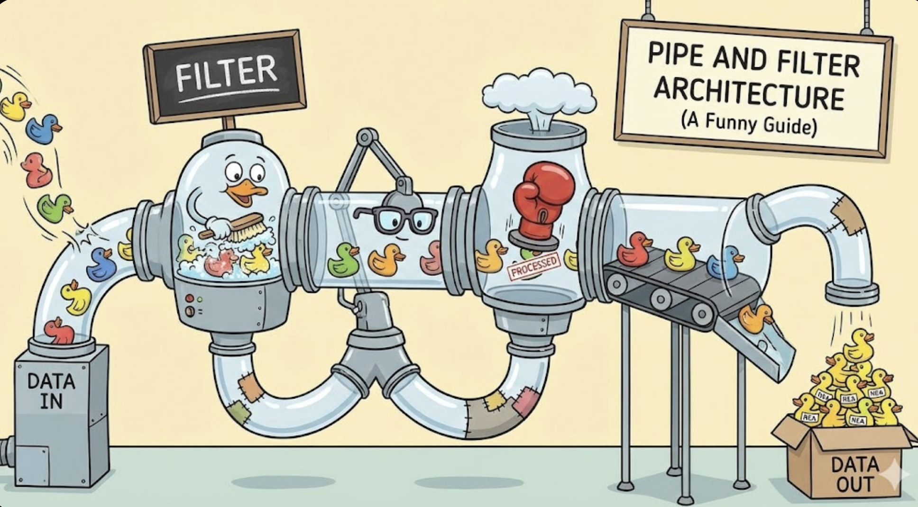

Slide 9
Pipe and Filter Architecture Pattern
The Pipe and Filter architecture is a software design pattern where data flows through a series of independent processing units called filters, connected by pipes.
Each filter performs a specific transformation on the data, and pipes transfer the processed data to the next filter.
This pattern is ideal for systems that require data transformation or stream processing, as it promotes modularity, reusability, and separation of concerns.
Filters don’t need to know about other filters; they simply process data and pass it along, which makes the system easy to extend and maintain.
E.g. a text-processing pipeline:
The data flows through each filter, getting processed step-by-step. Filters are independent, making the system easy to modify. New filters can also be added or swapped as needed.

Slide 10
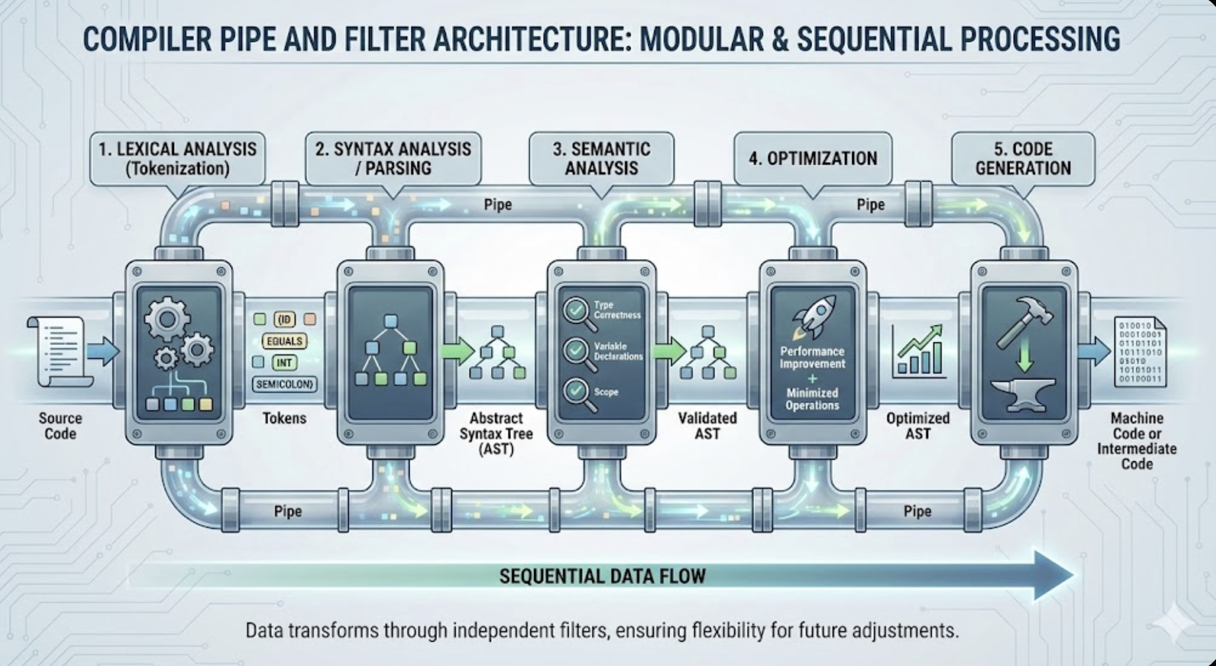

Slide 11
Pipe and Filter cont..
The Pipe and Filter architecture is characterized by modularity, reusability, and composability.
Each filter is self-contained and can be developed and tested independently. The pattern also supports separation of concerns, since every filter handles a single task.
Pipes allow flexible data flow between filters without requiring changes to the filters themselves.
This pattern offers several advantages. It is easy to maintain because each filter has one responsibility. It is also modular, allowing filters to be added or replaced without affecting the whole system.
Filters are reusable and can be arranged in different combinations, which improves flexibility. The style also supports parallelism, allowing filters to run at the same time for better performance.
However, it has some drawbacks. A slow filter can create performance bottlenecks in the whole pipeline. Passing complex or large data between filters can be difficult and may require extra processing.
Error handling is also challenging because filters work independently and failures can be harder to coordinate.

Slide 12
Pipe and Filter types
Synchronous vs. Asynchronous Pipelines: Synchronous pipelines execute filters sequentially, while asynchronous pipelines allow concurrent processing, improving performance.
Parallel Pipelines: Filters can run in parallel, processing independent tasks simultaneously to speed up data processing.
Distributed Pipelines: Filters can be distributed across multiple machines or services, allowing for scalability in large systems.
Pipe and Filter architecture is widely used in:
Data processing pipelines (ETL systems).
Compiler design (phases like lexical analysis, parsing, optimization).
Audio/video processing (filters for encoding, filtering, transformation).
Event-driven systems (real-time analytics and processing).
Pipe and Filter integrates well with the Strategy, Decorator, and Observer patterns, letting filters act as transformation strategies, enhance data, and notify other components during processing.

Slide 13
Thank You☺

